Slide 1
Complex Geometry
Vectors, Roots of Unity & Regular Polygons

Slide 2
Vectors on the Complex Plane
When we consider what a complex number is, there are lots of possible answers.
A good answer is “a rotation,” but perhaps the most intuitive is a vector: an ordered collection of numbers.
Complex numbers are made of a real component, and an imaginary component.
Copyright: © 2010 Universal Studios.

Slide 3


Vectors on the Complex Plane
Addition and subtraction are defined in a simple way:
Multiplication is equally intuitive:
Division is gross in this form, so we generally convert to polar form first.
$$\left(a+bi\right)±\left(c+di\right)=\left(a±c\right)+\left(b±d\right)i$$
$$\left(a+bi\right)×\left(c+di\right)=\left(ac −bd\right)+\left(ad+bc\right)i$$

Slide 4





Polar Form
Polar form means to write in terms of a direction and magnitude. Generally we write
We can then write some operations in a more simple way
$$z=r \operatorname{cis}{θ}$$
$$\frac{r\operatorname{cis}{θ}}{s\operatorname{cis}{φ}}=\frac{r}{s}\operatorname{cis}\left(θ−φ\right)$$
$$|z|=r$$
$$\arg{(z)}=θ$$
$${\left(r \operatorname{cis}{θ}\right)}^{n}=r^{n}\operatorname{cis}{nθ}$$

Slide 5
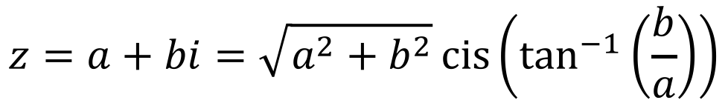

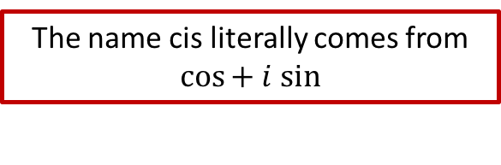
Rectangular to Polar
The name cis literally comes from $cos⁡+ i sin$
$$z=a+bi=\sqrt{a^{2}+b^{2}}\operatorname{cis}\left(\tan^{−1}\left(\frac{b}{a}\right)\right)$$
$$z=r\operatorname{cis}{θ}=\left(r\cos{θ}\right)+\left(r\sin{θ}\right)i$$

Slide 6
Argand Diagram

Slide 7


Extra: The most beautiful formula
Yes, it really is pronounced “Oil-er.”
The most beautiful formula in mathematics is generally thought to be Euler’s Identity.
This is a special case of Euler’s Formula:
$$e^{iπ}+1=0$$
$$e^{iθ}=\cos{θ}+i\sin{θ}$$

Slide 8
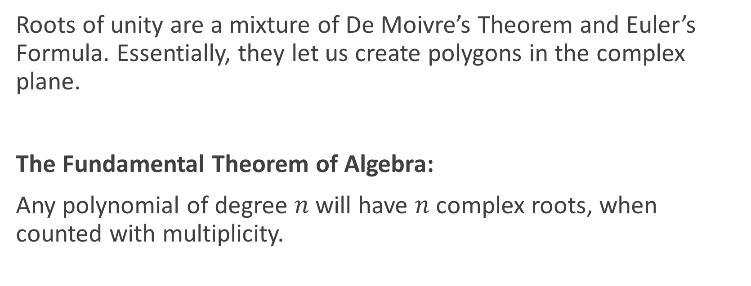
Roots of Unity
Roots of unity are a mixture of De Moivre’s Theorem and Euler’s Formula. Essentially, they let us create polygons in the complex plane.
The Fundamental Theorem of Algebra:
Any polynomial of degree $n$will have $n$complex roots, when counted with multiplicity.

Slide 9

Roots of Unity
The roots of unity come from the formula
and are always distributed at equal intervals around the origin.
$$z^{n}=1$$

Slide 10
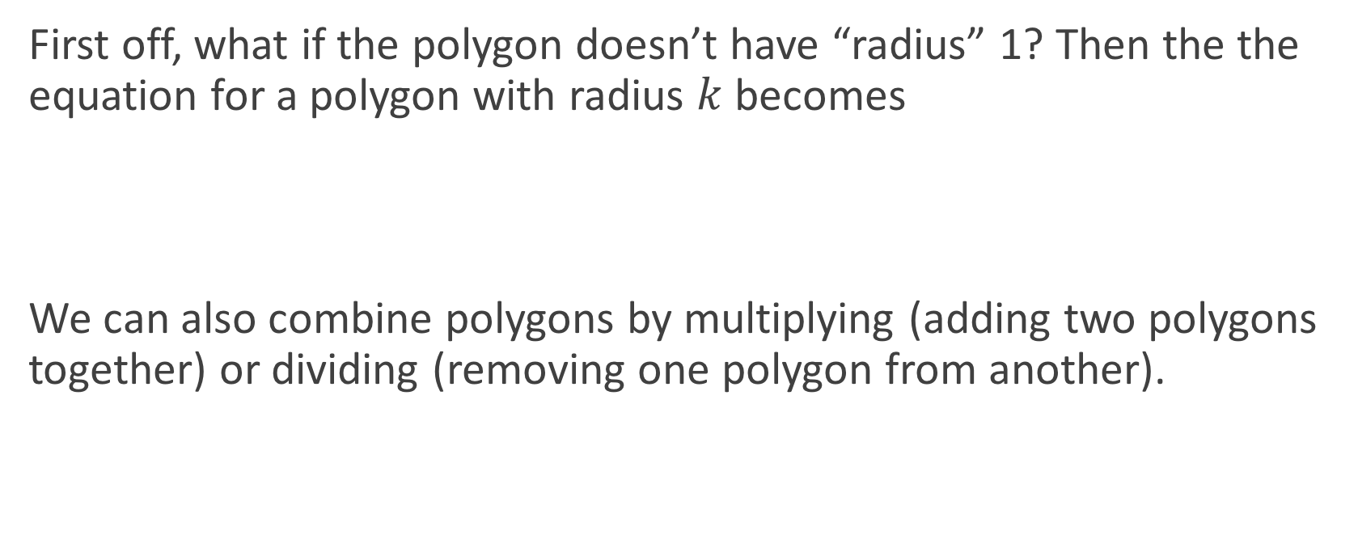

Irregular Polygons
First off, what if the polygon doesn’t have “radius” 1? Then the the equation for a polygon with radius $k$ becomes
We can also combine polygons by multiplying (adding two polygons together) or dividing (removing one polygon from another).
$$z^{n}=k^{n}$$

Slide 11





Example
What is the complex polynomial to generate the following shape?
$$z^{4}=2^{4}$$
Square
$$z^{4}−16=0$$
$$z^{3}=2^{3}$$
Triangle
2
$$z^{3}−8=0$$
$$\left(z^{4}−16\right)\left(z^{3}−8\right)=0$$
Combined

Slide 12
Do Now
Any Questions?
Delta Workbook
Nothing this time.
Workbook
Pages 213-215, 221-222

Slide 13

This work is licensed under a Creative Commons Attribution-NonCommercial-ShareAlike 4.0 International License.
Aaron Stockdill
2016

